Slide 1

Archdiocese of Seattle
New Bookkeeper Training
PARISH FINANCIAL SERVICES
MAY 2025

Slide 2
Objectives
provide an overview of church accounting
understand church financial policies and procedures
improve awareness of key aspects of internal control
learn proper recording of transactions
make new bookkeepers aware of the resources available to them to support their work in Catholic parishes

Slide 3

Bookkeeper Tasks
Data entry
Tracking accounts payable and receivable
Bank reconciliation
Invoicing
Payroll processing
Financial reporting
Maintaining records
Budgeting
Communication

Slide 4
Fiscal Year Schedule
July – verify that employee pay rates, allowances, and benefit elections took effect
in the applicable pay period
August – insurance bill sent to parish; payment due September
August 15 – Parish Annual Report due
September – assessment bill sent to parish
November – obtain Transmitter Control Code (TCC) from IRS if e-filing 10 or more 1099 forms
December – designate priest housing allowance
January
send 1099 forms to vendors
send parishioner annual tax statements
February
budget letter sent to parish
ACA goal sent to parish
March/April – assist PAA with budget development
April and October – property tax assessment due
June – review employee pay rates, allowances, and benefit elections for the upcoming fiscal year

Slide 5
Month-End Tasks
Reconcile bank accounts, including PRF
Reconcile credit card statements, endowment and investment accounts
Record all transactions
Ensure payroll is recorded accurately
Review accounts payable and receivable
Verify restricted funds
Prepare and review month-end financial reports – Balance Sheet, P&L, Budget vs Actual report
Close the month by setting closing date in QuickBooks

Slide 6
Fiscal Year-end Closing (June 30)
Prepare adjusting entries for any accrued income and expenses
Review and adjust the following:
payables and receivables
restricted, custodial, and designated funds
deferred revenue
Prepare yearend financial reports - Balance Sheet, P&L, Budget vs Actual report

Slide 7
Year end tasks (December)
The following tasks may be completed with the PAA or other staff or Finance Council.
Obtain Transmitter Control Code (TCC) from the IRS if expecting to file 10 or more 1099 forms - apply through the IRIS Taxpayer Portal (typically takes about 45 business days)
Establish housing allowance by December 31st
Form 1099-NEC, 1099-MISC – due January 31st of the next calendar year
review all vendor payments to determine those who received $600 or more
prepare for mandatory electronic filing requirements for 10 or more returns
Prepare contribution receipts or letters – due January 31st of the next calendar year
Notes:
Transmitter control code – may start process of obtaining as early as November to give enough time for IRS to process
Designation of housing allowance must be in writing , such as in an employment contract or in minutes of a meeting or board resolution made by the Finance Council
Housing allowance may or may not be included on the priest’s W-2 Form

Slide 8
Financial Policies and Procedures
Notes:
The purpose of these policies and procedures is to ensure that the church has adequate internal controls to ensure the integrity and accuracy of financial operations within the church. In summary, our policies and procedures encompass several key aspects:

Slide 9

Website Link: https://archseattle.org/parish-financial-services
Notes:
The Parish Accounting Manual provides a valuable resource not just for new bookkeepers but for all staff involved in the parish’s financial operations. The manual should be the first place bookeepers should look at when they have questions relating to policies and procedures.

Slide 10
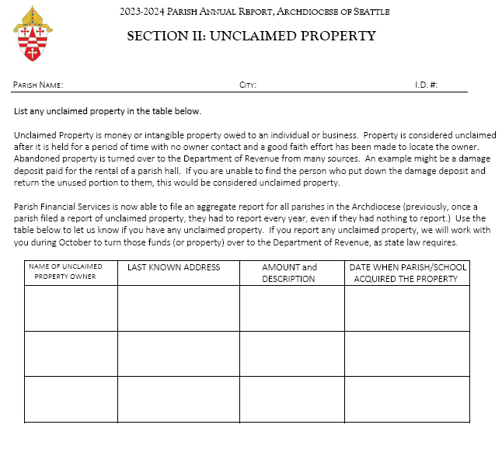
Parish Annual Report (PAR)
Due August 15
Data is for the immediately preceding fiscal year
Chancellors Office manages the process
PFS extracts financial data from Qvinci
Parish sends Unclaimed Property Information through Section II of the PAR
Other information provided by parish – data uploaded to a location provided by the Chancellors Office
Notes:
Qvinci is a software that allows the Archdiocese to consolidate financial data from the parishes to provide a comprehensive view of financial performance.
Qvinci’s mapping of accounts enables the Archdiocese to align various accounts used by the parishes to the standardized Chart of Accounts as contained in the Parish Accounting Manual.

Slide 11
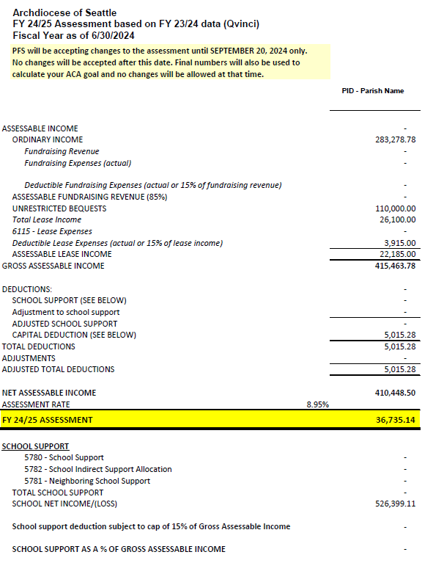
Parish Assessment
Gross Assessable Income
Ordinary income – accounts 4101 to 4109
Fundraising revenue – 85% of gross fundraising revenue, or gross fundraising revenue minus actual fundraising expenses if actual expense > 15% of gross fundraising revenue
Unrestricted bequests
Lease revenue – 85% of gross lease revenue, or gross lease revenue minus actual lease expenses if actual lease expenses > 15% of gross lease revenue
Deductions
School support (direct and indirect) – capped at 35% of gross assessable income and only up to the extent that the school does not have a surplus
- Indirect support must be recorded in the GL
Capital expenditures – capped at 15% of gross assessable income
Assessable income = Gross assessable income minus Deductions
Assessment = Assessable income multiplied by assessment rate established by the Archdiocese
Notes:
Indirect support must be recorded in the accounting system for it to be included in the calculation. PFS is not accepting indirect support information outside of transactions recorded in QuickBooks.

Slide 12
Allowable School Support Deduction
Scenario 1:
Parish school support expense = $50,000
School net loss = $20,000
Tentative Allowable school support deduction* = $50,000
Scenario 2:
Parish school support expense = $50,000
School net income = $70,000
Tentative Allowable school support deduction* = $0
Scenario 3:
Parish school support expense = $50,000
School net income = $30,000
Tentative Allowable school support deduction* = $20,000
* The final allowed school support is capped at 35% of gross assessable income. The home parish expense may also be adjusted if the school received support from neighboring parishes.

Slide 13
Parish Financial Operations Review (PFOR)
Conducted every 3 years
Parish fills out PFOR questionnaire sent by PFS through the mail or download from the website:
https://archseattle.org/parish-financial-services/parish-financial-services-internal-resources
Bookkeeper provides documents required by the reviewer
Bookkeeper, PAA and other parish staff meet and work with the reviewer during the site visit
PFS sends letter of findings and recommendation to the pastor
PFS conducts follow-up on implementation of recommendations after 90 days

Slide 14

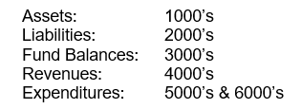
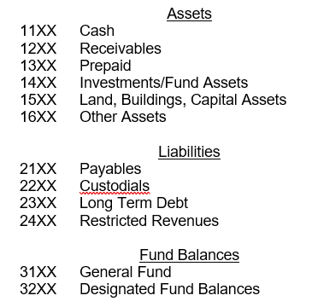
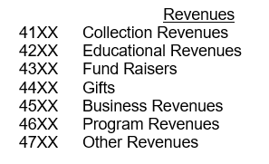
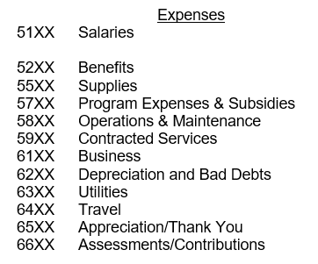
Chart of Accounts
MAIN ACCOUNT CLASSIFICATION
Notes:
Review your Chart of Accounts to ensure that the account numbering conforms with the Archdiocesan numbering system

Slide 15
Account Structure
The complete account number is a 6-digit number in the format xxxx.xx
The 1st digit is the account type.
The 2nd digit is the category type.
The 3rd and 4th digits are the item numbers.
The 5th and 6th digits are the programs.
The account number 5 1 20 . 10 is: EXPENSE, SALARIES, LAY SALARIES, PARISH
The account number 5 1 20 . 80 is: EXPENSE, SALARIES, LAY SALARIES, SCHOOL
If you changed the 1st digit to show 4 1 20 . 10 : REVENUE, COLLECTIONS, BUILDING FUND DRIVE REVENUE, PARISH

Slide 16
Custodial, Restricted, and Designated Funds
Custodial
Parish Custodial Funds - amounts entrusted to the parish for the purpose of holding, receiving and disbursing such funds for another agency or institution (e.g., Altar Society, Parents Club)
Custodial Collections – scheduled by the Archdiocese (e.g., Peter’s Pence)
Restricted – contributions received with conditions or limitations set by the donor on how the funds can be used.
Designated – amount set aside by parish leadership for a specific purpose; can be undesignated anytime (e.g. ACA rebate)
Notes:
When doing the “ask” for restricted funds, it is a good practice to include a provision in case there are leftover funds after the purpose of the restriction is fulfilled.

Slide 17
Fixed Assets
Capital expenses above $10k must be recorded as fixed assets
Depreciation – optional but is the standard accounting practice
If you are currently depreciating and would like to discontinue, just stop recording depreciation expense
The expense for the fixed asset will not show up in the P&L if you are not depreciating
Might need to do prior period adjustment for accumulated depreciation if you sell or dispose the fixed asset in the future
Capital expenses that are not capitalized lose out on the capital expense deduction in the assessment
Notes:
3rd Bullet:
In calculating the assessment, capital expenses incurred by the parish and school reduces assessable income by the amount of capital expense up to 15% of gross assessable income.
PFS determines the capital expense for the FY by getting the increase in the fixed asset balance from the previous fiscal year from the comparative Balance Sheet. If there is a decrease in the fixed asset balance that may be due to the sale or disposal of the fixed asset, PFS will communicate with the parish to ensure that any capital expenses incurred for the year are appropriately included in the assessment calculation.

Slide 18
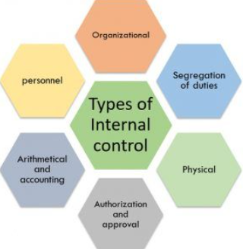
Key Aspects of Internal Control
Segregation of Duties
Authorization and Approval
Compliance with Policies and Procedures
Training and Awareness
Physical security
Monitoring and Review
Documentation and Record Keeping
Reconciliation
Technology and System Controls
Notes:
Preventing Fraud and Errors - segregation of duties means dividing responsibilities to reduce the risk of fraud and errors. For example, staff requests for reimbursement, the PAA approves the request, and bookkeeper records the transaction. Ensure that all transactions are properly authorized and approved.
2. Ensuring Compliance
- regulatory compliance: compliance with regulations means to adhere to laws, regulations, and policies applicable to the church (for example, maintaining tax-exempt status, filing requirements for UBIT, acknowledgment for contributions of $250 or more, property tax exemption)
- regular training sessions to ensure compliance with internal policies and procedures.
3. Safeguarding Assets - physical Security to protecting physical assets and sensitive information. (e.g., use of tamper evident bags for collections; keeping collections and Scrip cards in safe); regularly monitoring and reviewing financial activities to detect and correct issues.
4. Accurate Financial Reporting - maintaining accurate and complete records of all transactions. Regularly reconciling accounts ensures accuracy of accounting records.
5. Promoting Operational Efficiency – streamlining financial processes to improve efficiency and reduce waste and utilizing technology to enhance control measures.

Slide 19
Bank Reconciliation
Reconcile monthly within 10 working days from bank statement cutoff date
person reconciling must sign and date the bank reconciliation
Bank statements must be reviewed by Pastor or PAA prior to reconciliation
Note: Reviewer must not be involved in updating financial records
Pastor or PAA must review, sign and date bank reconciliation
Note: the person approving must not be involved in the check approval and writing process
Reconcile PRF accounts
Reconcile bank accounts of parish sponsored organizations (bookkeeper or the Treasurer of the organization)
Notes:
Review of bank statements and reconciliations should cover items such as:
Unusual withdrawals, debit card activity, and Electronic Funds Transfer (EFT) or Automated Clearing House (ACH) transactions
Deposit patterns to see if they match normal operations
Large items
Normal payroll entries
Long outstanding items
Duplicate payments or unauthorized payments
Transfers in and out of an account which could be sign of theft.

Slide 20
Bank Reconciliation (continued)
Print Balance Sheet as of bank statement cutoff date.
Print completed bank reconciliation summary and details from accounting software.
Compare cash balance per Balance Sheet with register balance per bank reconciliation.
If the balances don’t match, investigate and resolve possible causes
Transactions deleted from a prior period that has been reconciled
Transactions added to a prior period that has been reconciled
Review and resolve long outstanding deposits and checks (more than 60 days)
cancel or reissue checks
send to Unclaimed Property through Parish Annual Report process
DO NOT DELETE OR ADD TRANSACTIONS TO A PRIOR PERIOD THAT HAS BEEN RECONCILED!
Notes:
2. Reviewer of bank statements and reconciliation must sign and date the statement and reconciliation
3. Compare register balance per the bank reconciliation and the GL balance as of bank reconciliation cutoff date
Items that have been cleared in previous reconciliations must not be deleted or changed in the reconciled period but adjusted through a journal entry in the current period
4. Long outstanding checks
contact payees and document attempts to contact (emails, letters, phone calls)
void and reissue check
send to Unclaimed Property – during the Parish Annual Report due August 15

Slide 21
Cash Receipts
Bookkeeper must not:
be involved in counting collections
be updating parishioner records (ParishStaq)
Bookkeeper must:
reconcile bank deposit with tally sheets
reconcile postings to parishioner records with deposit amount
for proper recording of electronic receipts, consider timing difference between when contributions were given and when they actually hit the bank
Other Considerations
Collections deposited no later than first business day following the service (remote check deposit through scanner is allowed)
Restrictive endorsement of checks
Issuance of three-part receipt for miscellaneous cash receipts
Cash and checks collected during fundraising events and other events must be deposited intact
Notes:
1st bullet
Collection counters must be made up of volunteers. Parish staff may occasionally participate in the count, as long as they are not involved in the financial recordkeeping for the parish.
Volunteers in a count team must not be related. Related individuals such as husband and wife may count as long as they are not in the same count team.
2nd bullet - A volunteer must update parishioner records.
3rd bullet – reconciling with tally sheets also allows the bookkeeper to review the proper classification of contributions received

Slide 22
Parishioner Statements
Send out no less than twice a year
Separate acknowledgment for each single contribution of $250 or more
In-kind donations – acknowledge only receipt of goods but no value
Sample statements are in Appendix A-3 of the Parish Accounting Manual
https://archseattle.org/wp-content/uploads/2023/A-Appendices.pdf

Slide 23
Disbursements
All disbursements must be approved
- Reimbursements and non-recurring expenses – approved check request
Recurring transactions – invoice or bill signed and dated by approving officer
No one can approve their own check request
Reimbursement requests
must comply with Accountable Expense Reimbursement Plan
must be submitted within three months after expense was incurred
Automatic payments – list of vendors must be approved annually
No one can sign their own checks, including pastor
Refer to Guidelines on Parish vs Business Expenses
https://archseattle.org/wp-content/uploads/2024/02/Parish-vs-PersonalExpenses-Chart.pdf
Notes:
2nd Bullet: Under accountable expense reimbursement plan, expenses will not be considered taxable income if the expenses are supported by documentation like invoices or receipts. Unsubstantiated expense will be considered taxable wages and will be included in the employee’s W-2.

Slide 24
Electronic Disbursements
Adequate paper trail with documented approval of the transaction
Review annually to determine continued necessity of the expenses
EFTs, including ACH, are limited to specific pre-determined bank accounts (e.g., payroll bank account) and amounts
Adequate computer safeguards and software to protect financial information
Wire transfer instructions must be made through personal contact
Notes:
The parish may only do wire transfers upon instruction of the pastor, priest administrator, pastoral coordinator, or other appointed pastoral leader. Instructions must be made through personal contact. Instructions through e-mail or other communication other than personal contact is absolutely prohibited.

Slide 25

Credit Cards
All charges must be approved
All charges must have receipts or invoices
- undocumented expenditures will be considered compensation and added to the individual’s W-2.
Credit card statement must be approved prior to payment
Credit cards must not allow cash advances
Employees who have been issued a credit card must sign a credit card agreement
Sample Credit Card Agreement can be found on the Parish Accounting Manual, Appendix A-6
https://archseattle.org/wp-content/uploads/2023/11/A-Appendices.pdf
Notes:
1st Bullet
the person having budgetary responsibility for the expense (e.g., department head) should approve the expense

Slide 26
Payroll
Review and approval of payroll reports by someone not involved in the payroll processing process
Example: bookkeeper processes payroll, pastor or PAA approves payroll
Bonuses are taxable income
- IPBS does not allow gift cards, including Scrip, to be processed through payroll
Backup payroll processor
Reconcile payroll JE with the payroll report
- Use Payroll Distributed Detail and Summary Report for the JE
Notes:
Payroll review should include the following:
Employment status
Hours worked, especially for overtime
Pay rates
Hourly rates for non-exempt employees
Salaries for exempt employees
Pay rate changes or adjustments
Deductions, especially benefit elections for the new fiscal year and for any new employee hired during the year

Slide 27
Priest Payroll
The Vicar for Clergy’s office sets up priest’s payroll.
Dual status taxpayer – classified as employee for income tax purposes, considered self-employed for self-employment tax (SECA) purposes
Pay both employer and employee portion of the SE tax
Tax equity payment (TEP) by the Archdiocese is a reimbursement for SE tax paid
Exempt from payroll withholding but may submit W-4 for voluntary withholding
Salary, allowances, stipends, TEP are subject to federal income tax
Housing allowance is subject to SE tax but not subject to federal income tax
Notes:
SECA is Self Employment Contributions Act – pay both employer and employee share of the FICA which funds Social Security and Medicare Programs
The SE tax is the equivalent of the social security and medicare taxes, or FICA, for lay employees

Slide 28
Priest and Deacon Education Fund
Funded by the parish
amount per year
- $1,000 per year for priests
- $700 per year for deacons
Remit unused portion as of June 30 to the Office of the Vicar for Clergy (OVC)
Maximum accumulation
$5,000 for priests
$3,500 for deacons
Priest or deacon makes a written request to OVC if he wishes to make a withdrawal
Unclaimed funds for deceased priest of deacon goes to the Priest Continuing Education Fund or Deacon Continuing Education Fund
Eligible Uses
Classes, workshops, books, periodicals, convocations, other expenses directly related to professional development and priestly or diaconal ministry
Software programs that would help in priestly or diaconal ministry
Ineligible Uses
Annual retreat the priest may want to take
Expenses associated with the annual priest institute (Priest Days)
Archdiocese Annual Deacon Retreat or the Deacon Convocation
Computer hardware
Contact Jan Augustavo at jan.augustavo@seattlearch.org for questions
Notes:
The Priests’ Continuing Education Account was approved by the Presbyteral Council in July 1994
The Deacons’ Continuing Formation Account was promulgated by the Archbishop in August 2000.

Slide 29
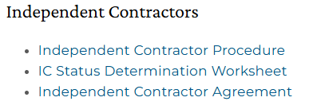
Independent Contractor (IC)
Obtain W-9 before paying
- if IC refuses to provide W-9, withhold 24% of the payment (backup withholding)
1099-NEC – required if total payment for the calendar year is at least $600
Stipends to priests might require 1099-NEC
IC Status Determination
Refer to HR site: HR Toolkit_Admin Resources - Archdiocese of Seattle
If answer is “No” to any of the questions in the IC status determination worksheet, call Human Resources.
Notes:
Backup withholding
Report withholding using IRS Form 945 – Annual Return of Withheld Federal Income Tax
Deposit withheld amount through the Electronic Federal Tax payment System (EFTPS) or by maling a check with a deposit coupon
File form 945 by January 31 of the year following the year in which the taxes were withheld

Slide 30


Gambling
Establish separate bank account
Apply for gambling license, if needed
- contact PFS for authorization letter from Archdiocesan General Counsel
Raffle winnings, if reportable, are reported on form W-2G
Refer to Washington State Gambling Commission website for detailed rules on licensing and reporting
https://wsgc.wa.gov/
https://wsgc.wa.gov/licensing/activities-dont-require-license/charitable-and-nonprofit-activities-dont-require-license
https://wsgc.wa.gov/rules-enforcement/activities-we-regulate

Slide 31
Unclaimed Property
Uncashed checks that are outstanding for one year or more
Conduct due diligence before sending to State
Reporting period end date is June 30
Annual reporting deadline is October 31 of each year
- PFS reports on behalf of parish
- Parish submits Unclaimed Property information PFS during the Parish Annual Report submission due August 15
- Parish sends payment for unclaimed property to CCAS so that PFS can remit with the filing
Direct any questions to Scott Bader
Notes:
Due diligence involves contacting owners by sending a due diligence letter or email to the last known address of the owner

Slide 32
Budgeting
Budget Development
Data Collection – gather historical data
Analysis – past financial performance to identify trends
Collaboration with PAA and other departments or ministries
Budget Implementation
Record Keeping – accurate recording of transactions
Monitoring – track actual income and expenses against budget
Compliance – ensure spending adheres to budget and financial policies
Budget Reporting
Preparation – budget vs. actual report
Analysis – identify significant variances
Communication - Bookkeepers present the financial reports to management and stakeholders, explaining the financial status and implications for future planning
Budgeting guidelines and budget template available on the PFS website!
https://archseattle.org/parish-financial-services/parish-financial-services-educational/
Notes:
Budget Development
Data Collection: Bookkeepers gather historical financial data, including income, expenses, and cash flow, to provide a foundation for the budget.
Analysis: They analyze past financial performance to identify trends and areas for improvement, helping to set realistic budget targets.
Collaboration: Bookkeepers work with management and other departments to understand their financial needs and goals, ensuring the budget aligns with overall business objectives.
Budget Implementation
Record Keeping: They ensure all financial transactions are accurately recorded in the accounting system, maintaining detailed documentation for future reference.
Monitoring: Bookkeepers track actual income and expenses against the budget, identifying variances and providing timely updates to management.
Compliance: They ensure that spending adheres to the budget and financial policies, helping to prevent overspending and financial mismanagement.
Budget Reporting
Preparation: Bookkeepers prepare regular financial reports, including budget vs. actual comparisons, to provide insights into financial performance.
Analysis: They analyze the reports to identify significant variances and their causes, offering recommendations for corrective actions.
Communication: Bookkeepers present the financial reports to management and stakeholders, explaining the financial status and implications for future planning

Slide 33
Charitable Contributions
Tax-Deductible Donations
Cash donations – cash, checks, credit/debit card payments, online payments
Non-cash donations – stocks, clothing, furniture, vehicles
Mileage and travel expenses related to volunteering ($0.14 cents per mile for 2025)
Donations of property – real estate, art, collectibles
Qualified Charitable Distributions (QCD) from IRAs for taxpayers aged 70½ or older
Non-Deductible Contributions
Donations to individuals – personal fundraisers (e.g., GoFundMe), direct gifts, or family assistance
Political Donations to political campaigns or lobbying organizations
Value of personal services or volunteer time
Raffle tickets and auctions
Value paid over the raffle ticket or fair market value of the auction item may be deductible
Raffle winner does not take a prize but donates it to the church
Notes:
Tax-Deductible Donations
5. QCD allows individuals aged 70 ½ or older to donate up to $100,000 per year directly from their IRA to a qualified charity. Donor informs their IRA administrator that they with to make a QCD. The distribution must be made directly from the donor’s IRA to the charity. An electronic payment or check made payable to the IRA owner does not qualify as a QCD.
Non-Deductible Contributions
Donation made by a parishioner either directly to the pastor or through the church is not deductible (since the church is directed to give the contribution to the pastor and does not unconditional control over the funds).
If a parishioner asks for tax donation letter for services, do not recommend that you pay the parishioner, then ask the parishioner to donate it back to the church. This does not result to any tax advantage to the parishioner since the deduction is offset by inclusion of the same amount as income. He may even be worse off if he is not itemizing his deductions since the income is included but there is no offsetting deduction.
The same is true for gambling winnings that the winner does not claim but instead wants a tax donation letter.
However, unreimbursed expenses such as transportation expenses or materials and supplies used for the charitable purpose may be deductible.

Slide 34
Timing of Charitable Contributions
General Rules
Calendar Year Basis – must be made by December 31 of the tax year
Cash Contributions – when they are delivered
Checks received in the mail - deductible in the year it is mailed (postmarked), not when it is cashed
Postdated checks - deductible in the year the church can actually cash the check
Electronic payments (credit/debit card, online transfers, text, pay-by-phone) - deductible in the year the transaction is completed.
Non-Cash Contributions – deductible in the year the items are delivered to the charity
Complete Form 8283, Section B, Part V for property valued over $5,000
Special Considerations
Stocks
deductible on the date the stock certificate is endorsed and delivered to the charity or it’s agent
if you give stock certificate to your agent, stock is considered delivered when stock is transferred on the books of the charity
QCDs – transfer must be completed by December 31
Notes:
2. Cash Contributions
Postdated Check: If you write a check on December 31, 2025, but postdate it to January 5, 2026, the donation is deductible in 2026, not 2025, even if the check was dropped in the basket on December 31, 2026
Predated Check: If you deliver the check dated December 31, 2025 on January 1, 2026, it is a 2026 donation since it was delivered during that year.
Regular Check: If you mail a check on December 31, 2025, and it is postmarked on that date, the donation is deductible in 2025, even if the charity cashes it in January 2026
Text message - on the date contribution is charged to your telephone or wireless account
Credit Card – on the date you make the charge
Pay by Phone – on the date the financial institutions pays the amount
3. Non-Cash Contributions Form 8283 – mostly completed by donor but signed by the parish

Slide 35
Deposit and Loans System (DLS online)
Each user must have their own account
To create account, contact:
Loretta Griffin (loretta.griffin@seattlearch.org) or
Arlene Stace (arlene.stace@seattlearch.org)
Request withdrawal of funds
- Actual withdrawal of funds is done by PFS
Request for transfers between PRF accounts (savings and loan accounts)
Set up automatic loan payment – email Parish Revolving Fund office
Check savings and loan balances
Print reports
For questions on DLS, contact Loretta Griffin or Arlene Stace.

Slide 36
Reporting Fraud, Abuse and Misconduct
EthicsPoint is a comprehensive and confidential reporting tool that enables management and employees to work together to address fraud, abuse, and other misconduct in the workplace while cultivating a positive work environment.
To make a report, click on this link: EthicsPoint
https://secure.ethicspoint.com/domain/media/en/gui/47276/index.html
Notes:
Bookkeepers can play a significant role in identifying fraud, waste, and abuse within an organization. While they may not be the primary line of defense, their detailed knowledge of financial transactions and records positions them well to spot irregularities and discrepancies that could indicate fraudulent activities.

Slide 37
Journal Entries

Slide 38
RESTRICTED FUNDS
Restricted funds must be restricted by the donor.
Example: $5,000 is received for window repair
When restricted donations are received, record liability.
Debit 1115 - Checking – $5,000
Credit 2401 - Restricted for Window Repair - $5,000
When funds are spent, record expense and revenue, and reduce liability.
Debit 5801 – Repairs & Maintenance - $5,000
Debit 2401 - Restricted for Window Repair - $5,000
Credit 1115 - Checking – $5,000
Credit 4405 – Restricted Donations - $5,000
Note: If restricted donations were received for capital expenditure (at least $10,000), use Fixed Asset account (15xx) instead of expense account

Slide 39
Designated Funds
May be undesignated anytime.
Example: The Finance Council (FC) designates $5,000 of the ACA rebate for window repair
To establish designated fund:
Debit 3101 – Beginning Fund Balance - $5,000
Credit 3257 – ACA for Window Repair - $5,000
The total amount paid for the repair is $4,900.
Debit 5802 – Repairs & Maintenance - $4,900
Credit 1115 – Checking $4,900
Debit 3257 – ACA for Window Repair - $4,900
Credit 3101 – Beginning Fund Balance - $4,900
The Finance Council decides to undesignated the $100 unspent amount.
Debit 3257 – ACA for Window Repair - $100
Credit 3101 – Beginning Fund Balance - $100
Note: Instead of 3101 – Beginning Fund Balance, you may use the Retained Earnings account.

Slide 40
Custodial Funds
Owned by parish sponsored organizations (e.g. Altar Society) – adjust the general ledger balance periodically to match the bank statement balance
Example: GL Balance on June 30 is $1,200 while bank statement balance is $1,500
Debit 1119 – Altar Society - $300 (with separate bank account) OR
Debit 1115 – Checking - $300 (no separate bank account)
Credit 2211 – Altar Society - $300
Archdiocesan Special Collections (e.g. Mission Sunday)
Upon receipt of collections:
Debit 1115 – Checking - $500
Credit 2231 – Mission Sunday - $500
Upon remittance (within 4 weeks of collection)
Debit 2231 – Mission Sunday - $500
Credit 1115 – Checking - $500
Note: Revenues and expenses are NOT recorded for parish custodial funds and custodial collections.

Slide 41
Depreciation
Depreciation is optional but is the standard accounting practice.
To create a depreciation schedule, you need the following information:
Cost basis of asset
Expected life of the asset
Date the asset was put in service
Example:
The parish bought a car for $42,000 on July 1, 2021 and was immediately put in service.
The depreciable life is 5 years (per IRS guidelines).
Monthly depreciation = $42,000 ÷ 5 yrs ÷ 12 months = $700/month
Monthly Journal Entry:
Debit 6203 – Depreciation Expense - Equipment - $700
Credit 1580 – Accumulated Depreciation - $700
Note: Accumulated Depreciation is a contra-asset account. The account type is “Fixed Asset” but shows as a negative amount in the Balance Sheet.

Slide 42
Fixed Asset Sale and Purchase
information required
old asset – cost basis, accumulated depreciation
new asset – purchase price, trade-in value
if accumulated depreciation was not recorded, make a prior-period adjustment first
Example:
Continuing from previous example, you decide to sell your old vehicle on December 31, 2025. The accumulated depreciation would be $37,800 ($700 x 54 months from July 1, 2021). The book value is $4,200 ($42,000 - $37,800).
The new vehicle costs $50,000. The trade-in value of the old vehicle is $3,000. The net loss is $1,200 ($4,200 BV - $3,000 trade-in).
JOURNAL ENTRY | Debit | Credit
Accumulated Depreciation | $37,800
Loss on Asset Disposal | $ 1,200
Fixed Assets (cost of old vehicle |  | $42,000
Fixed Assets (cost of new vehicle) | $50,000
Cash/Checking |  | $47,000
Total | $49,000 | $49,000

Slide 43
Unrealized Gains and Losses
Occurs when the value of an investment changes due to market fluctuations
Not realized unless investment is sold or disposed of
Do not affect net income
Separately show within the Fund Balance section of the Balance Sheet (preferred practice)
Fund Balance Section:
3219 – Endowment Fund
3256 – Gain or Loss on Investments
Notes:
Usually applies to endowments and investments
Unrealized gain or loss on the investment is the difference between the cost of the investment securities and their fair value on the market. Unrealized and losses are just on paper since the investments have not yet been sold.

Slide 44
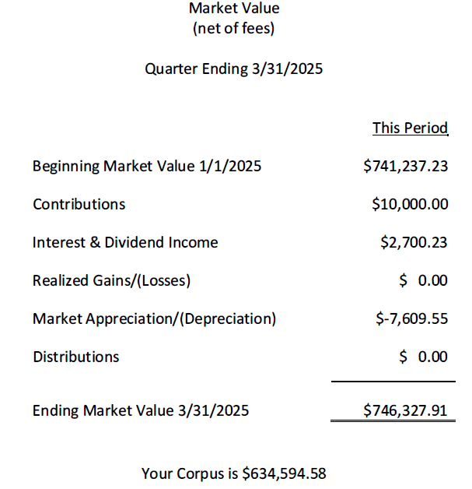
Endowments
JOURNAL ENTRY
DEBITS 1410 – Endowment Fund Assets $ 5,090.68
CREDITS
3219 – Endowment Fund $10,000
4512 – Reinvested Endowment Fund Earnings $2,700.23
Contributions $ 10,000.00
Interest/Dividends 2,700.23
Market Depreciation ( 7,609.55)
$ 5,090.68
3266 – Gain or Loss on Investment $7,609.55
BALANCE SHEET
Asset: 1410 – Endowment Fund Assets $ 746,327.91
Fund Balance: 3219 – Endowment fund $ 634,594.58
3266 – Gain or Loss on Investment $ 111,733.33
Notes:
Investment fees such as broker fees are typically deducted from overall investment returns, which can include both realized and unrealized gains.

Slide 45
Unclaimed Property
Example:
Check # 1413 remains uncashed for over a year. You decide to send this to Unclaimed Property after several unsuccessful attempts to contact the payee.
Report this in Section II of the Parish Annual Report due August 15
Void the check dated in the current FY
Debit 1115 – Checking
Credit 2101 – Accounts Payable
Record liability to the State
Debit 2101 - Accounts Payable
Credit 2460 - Unclaimed Property Liability (or Other Liabilities)
Send funds to PFS for remittance to Unclaimed Property
Debit 2460 - Unclaimed Property Liability (or Other Liabilities)
Credit 1115 - Checking

Slide 46
Payroll
Use the Payroll Distributed Summary and Detailed Report
Employer expenses include:
gross pay
employer taxes
employer-paid benefits
Payroll sweep includes:
net pay
employee and employer taxes
403b
FSA and HSA
long-term care
Benefits sweep – memo deductions, except:
blue collar and white collar
priest benefits (medical, dental, vision, group life)
HSA IPBS subsidy
The above is not an inclusive list.
Sample payroll JE is in Section D, Appendix D-2 of the Parish Accounting Manual
https://archseattle.org/parish-financial-services

Slide 47
Contact Information
Scott Bader – scott.bader@seattlearch.org / (206) 382-4585
Sarah Diama – sarah.Diama@seattlearch.org (206) 382-4573
Loretta Griffin – loretta.griffin@seattlearch.org (206) 382-4501
Arlene Stace – arlene.stace@seattlearch.org / (206) 382-4845
Accounting and Bookkeeping – Sarah
Budget Letter – Scott
Deposit and Loans System (DLS) – Loretta and Arlene
Parish Assessment – Scott and Sarah
Parish Financial Operations Review – Scott and Sarah
Parish Revolving Fund – Loretta and Arlene
Qvinci – Sarah
Stock Donations – Arlene
Unclaimed Property – Scott

Slide 48

We appreciate the important work
you do for your parish !!!
From your Parish Financial Services Team

