Slide 1
Archdiocese of Seattle
LADDER
SAFETY

Slide 2
LADDER SAFETY
What first?
Information
Review Knowledge

Slide 3
LADDER SAFETY
or

Slide 4
LADDER SAFETY
What first?
Review Knowledge
Information

Slide 6
LADDER SAFETY
Let’s Test You Knowledge

Slide 7
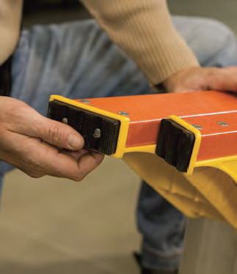
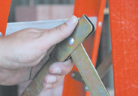
LADDER INSPECTION

Slide 8
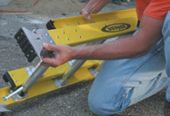
LADDER INSPECTION
Look over your ladder carefully when you buy it and each time before climbing.
Look for missing, damaged or loose components.

Slide 9
LADDER INSPECTION
Make sure that working parts move properly and that all connections are secure.
Carefully check spreaders, extension ladder locks, flippers and safety shoes.

Slide 10
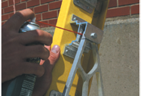
CARE & MAINTENANCE

Slide 11
CARE & MAINTENANCE
Keep ladders in good condition.
Clean spills or drips and keep the ladder free from oil, paint and other slippery materials.
Lightly lubricate moving
parts.

Slide 12
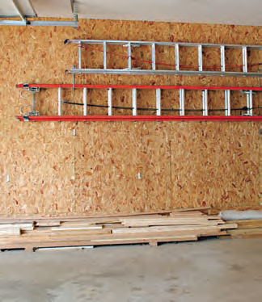
CARE & MAINTENANCE

Slide 13
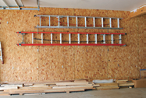
CARE & MAINTENANCE
Store ladders out of the reach of children.
Firmly support and protect ladders from heat, weather and corrosive materials.

Slide 14
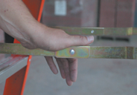
SAFETY BEFORE YOU CLIMB

Slide 15
SAFETY BEFORE YOU CLIMB
Fully open the stepladder and firmly lock both spreaders.
Position the ladder so you can face your work and do not have to lean sideways.

Slide 16
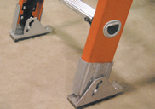
SAFETY BEFORE YOU CLIMB

Slide 17
SAFETY BEFORE YOU CLIMB
Be sure that all ladder feet are on firm, level ground.
Don’t place a ladder on slippery surfaces or place loose materials underneath a ladder.

Slide 18
SAFETY BEFORE YOU CLIMB
Place the extension ladder top so both rails are fully supported.
Support area should be at least 12" wide on both sides of the ladder.

Slide 19

SAFETY BEFORE YOU CLIMB

Slide 20

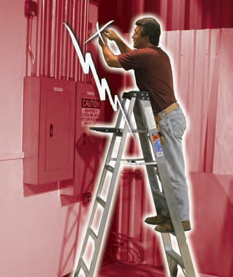
SAFETY BEFORE YOU CLIMB

Slide 21
SAFETY BEFORE YOU CLIMB
Use fiberglass ladders if there is even a remote possibility of working near electricity or overhead power lines.
Fiberglass side rails are electrically non-conductive.

Slide 22
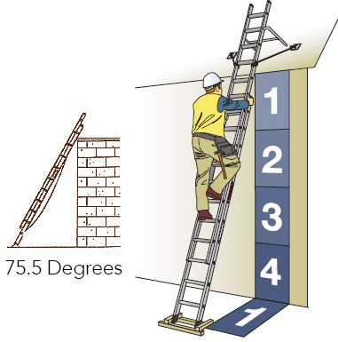
SAFETY BEFORE YOU CLIMB

Slide 23

SAFETY BEFORE YOU CLIMB
4 to 1 Rule
Set up your ladder at the required angle
For every 4 feet up, place the base of the ladder 1 foot from the wall or upper support that it rests against.

Slide 24
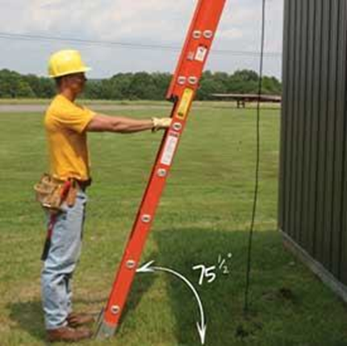
SAFETY BEFORE YOU CLIMB
4 to 1 Rule
Set up your ladder at the required angle
For every 4 feet up, place the base of the ladder 1 foot from the wall or upper support that it rests against.

Slide 25
SAFE CLIMBING HABITS
THE RIGHT WAY
THE WRONG WAY

Slide 26
SAFE CLIMBING HABITS
THE RIGHT WAY

Slide 27
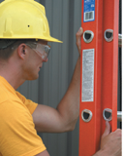
SAFE CLIMBING HABITS THE RIGHT WAY

Slide 28
SAFE CLIMBING HABITS THE RIGHT WAY
Be sure your ladder has been properly set-up and is used in accordance with safety instructions and warnings.
Wear shoes with non-slip soles.

Slide 29

SAFE CLIMBING HABITS THE RIGHT WAY

Slide 30

SAFE CLIMBING HABITS THE RIGHT WAY

Slide 31

SAFE CLIMBING HABITS THE RIGHT WAY

Slide 32
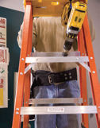
SAFE CLIMBING HABITS THE RIGHT WAY

Slide 33
SAFE CLIMBING HABITS THE RIGHT WAY
Keep your body centered on the ladder.
Hold the ladder with one hand while working with the other.
Never let your belt buckle pass beyond either ladder rail.

Slide 34

SAFE CLIMBING HABITS THE RIGHT WAY

Slide 35
SAFE CLIMBING HABITS THE RIGHT WAY
Move materials with extreme caution.
Be careful pushing or pulling anything while on a ladder.
You may lose your balance or tip the ladder.

Slide 36
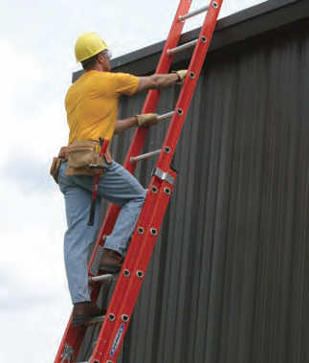
SAFE CLIMBING HABITS THE RIGHT WAY

Slide 37
SAFE CLIMBING HABITS THE RIGHT WAY
Climb facing the ladder.
Center your body between the rails.
Maintain a firm grip.
Always move one step at a time, firmly setting one foot before moving the other.

Slide 38
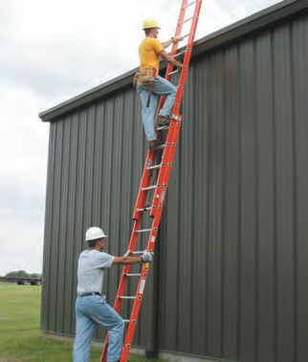
SAFE CLIMBING HABITS THE RIGHT WAY

Slide 39
SAFE CLIMBING HABITS THE RIGHT WAY
Get help with a ladder that is too heavy to handle alone.

Slide 40
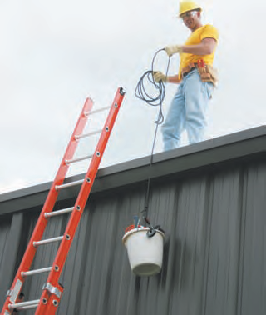
SAFE CLIMBING HABITS THE RIGHT WAY

Slide 41
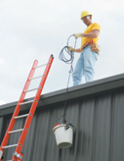
SAFE CLIMBING HABITS THE RIGHT WAY
Haul materials up on a line rather than carry them up an extension ladder.
Use extra caution when carrying anything on a ladder.

Slide 42
SAFE CLIMBING HABITS
THE WRONG WAY

Slide 43

SAFE CLIMBING HABITS THE WRONG WAY

Slide 44
SAFE CLIMBING HABITS THE WRONG WAY
Never use a damaged ladder.
Damaged ladders must be tagged for repair or disposal.

Slide 45
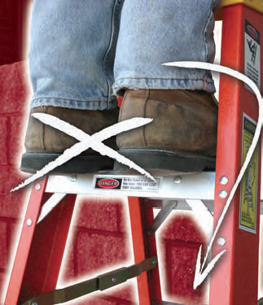
SAFE CLIMBING HABITS THE WRONG WAY

Slide 46

SAFE CLIMBING HABITS THE WRONG WAY
Don’t stand above the highest safe standing level.

Slide 47

SAFE CLIMBING HABITS THE WRONG WAY

Slide 48
SAFE CLIMBING HABITS THE WRONG WAY
Never climb a closed stepladder. It may slip out from under you.

Slide 49

SAFE CLIMBING HABITS THE WRONG WAY

Slide 50
SAFE CLIMBING HABITS THE WRONG WAY
Don’t stand or sit on a stepladder top. You could easily lose your balance or tip the ladder.
Ladder tops warn users not to stand or sit on them.

Slide 51

SAFE CLIMBING HABITS THE WRONG WAY

Slide 52

SAFE CLIMBING HABITS THE WRONG WAY
Never permit more than one person on a single-sided stepladder or on any extension ladder.
They are designed to hold only one person at a time.

Slide 53
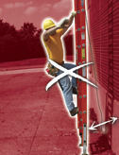
SAFE CLIMBING HABITS THE WRONG WAY

Slide 54
SAFE CLIMBING HABITS THE WRONG WAY
Do not place the base of an extension ladder too close to the building as it may tip over backward.
Do not place the base of an extension ladder too far away from the building, as it may slip out at the bottom.

Slide 55

SAFE CLIMBING HABITS THE WRONG WAY

Slide 56
SAFE CLIMBING HABITS THE WRONG WAY
Don’t climb on or off a ladder from the side.
You could push the ladder away and fall.

Slide 57
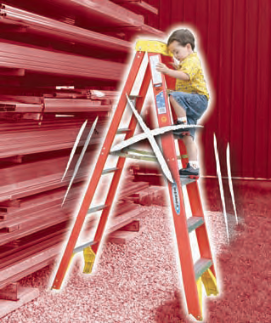
SAFE CLIMBING HABITS THE WRONG WAY

Slide 58
SAFE CLIMBING HABITS THE WRONG WAY
Never leave a ladder unattended. This may present a hazard to others in the area.
Do not allow children to play or climb on ladders.

Slide 59
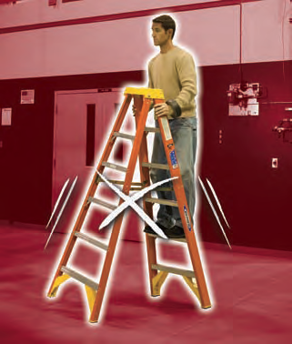
SAFE CLIMBING HABITS THE WRONG WAY

Slide 60
SAFE CLIMBING HABITS THE WRONG WAY
Never try to move a ladder while on it by bouncing or “walking” the ladder.
Step down and carry the ladder to the new working position.

Slide 61
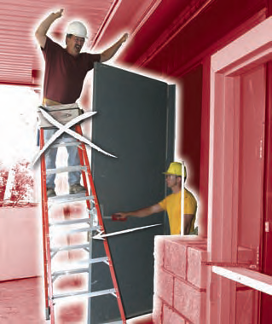
SAFE CLIMBING HABITS THE WRONG WAY

Slide 62
SAFE CLIMBING HABITS THE WRONG WAY
Never position the ladder where it blocks foot traffic, work vehicles, or where it could be bumped by a door.
If it is necessary to use a ladder in front of a door, lock or barricade the door and put up a caution sign.

Slide 63

SAFE CLIMBING HABITS THE WRONG WAY

Slide 64
SAFE CLIMBING HABITS THE WRONG WAY
Don’t place blocks, bricks or other loose materials under a ladder to adjust for unlevel ground.

Slide 65

SAFE CLIMBING HABITS THE WRONG WAY

Slide 66
SAFE CLIMBING HABITS THE WRONG WAY
Don’t over-reach, lean to one side or stand on one foot.
You could lose your balance or tip the ladder.

Slide 67

SAFE CLIMBING HABITS THE WRONG WAY

Slide 68
SAFE CLIMBING HABITS THE WRONG WAY
Never attempt to cut anything on a ladder.
Only use a properly equipped ladder or a saw horse.

Slide 69
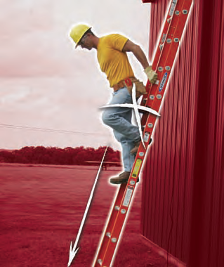
SAFE CLIMBING HABITS THE WRONG WAY

Slide 70
SAFE CLIMBING HABITS THE WRONG WAY
Don’t climb down a ladder with your back to the ladder.
You could easily slip or fall.

Slide 71
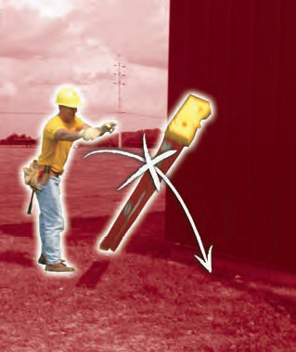
SAFE CLIMBING HABITS THE WRONG WAY

Slide 72
SAFE CLIMBING HABITS THE WRONG WAY
Never drop or throw ladders.
Doing so can damage or weaken them and cause serious injury to others.

Slide 73

SAFE CLIMBING HABITS THE WRONG WAY

Slide 74
SAFE CLIMBING HABITS THE WRONG WAY
Don’t climb from one ladder to another.
You may tip the ladder or slip and fall.

Slide 75

SAFE CLIMBING HABITS THE WRONG WAY

Slide 76
SAFE CLIMBING HABITS THE WRONG WAY
Never climb a closed stepladder.
It may slip out from under you.

Slide 77
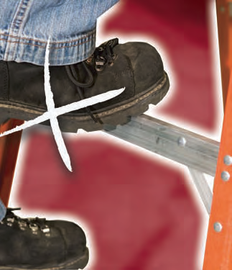
SAFE CLIMBING HABITS THE WRONG WAY

Slide 78
SAFE CLIMBING HABITS THE WRONG WAY
Don’t climb on the back of a single sided stepladder. It is not designed to carry a person’s weight.
Doing so can damage the ladder or result in an injury.

Slide 80
FINAL REVIEW FINAL ADVICE

Slide 81
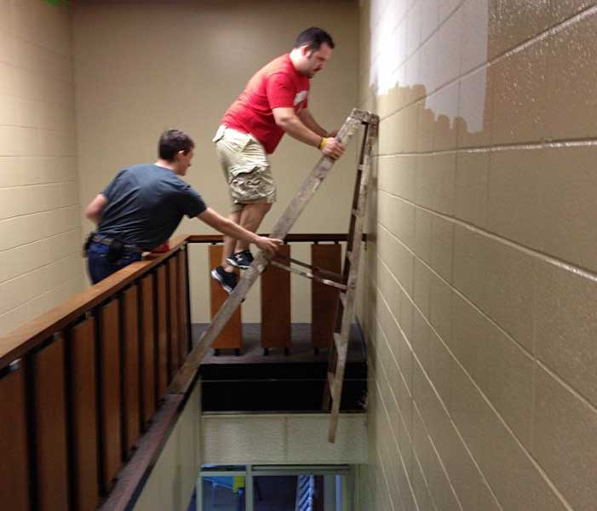
FINAL REVIEW

Slide 82
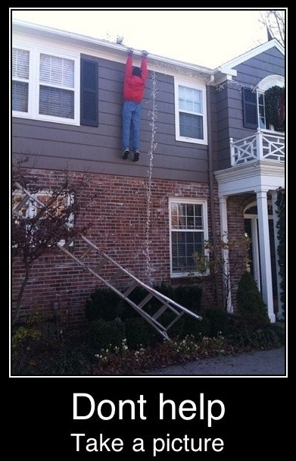
FINAL ADVICE

