Slide 1
Archdiocese of Seattle
CHURCH VOTIVE CANDLES
SAFETY ALERT

Slide 2
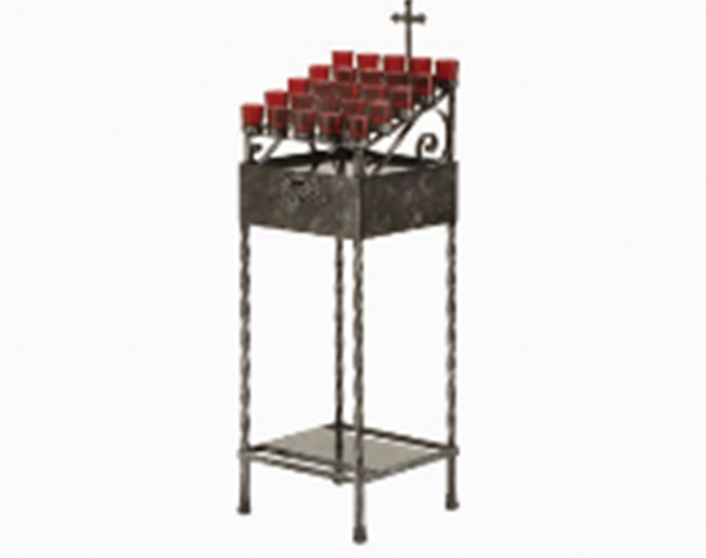
CHURCH VOTIVE CANDLES
These come in all sizes
SMALL

Slide 3
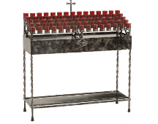
CHURCH VOTIVE CANDLES
These come in all sizes
MEDIUM

Slide 4
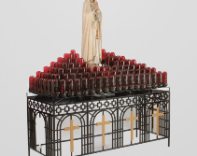
CHURCH VOTIVE CANDLES
These come in all sizes
LARGE

Slide 5
SERIES OF EVENTS
Mass concludes in the evening
Small votive holder fails and fire falls to the carpeted floor
Fire ignites surrounding flooring/area

Slide 6
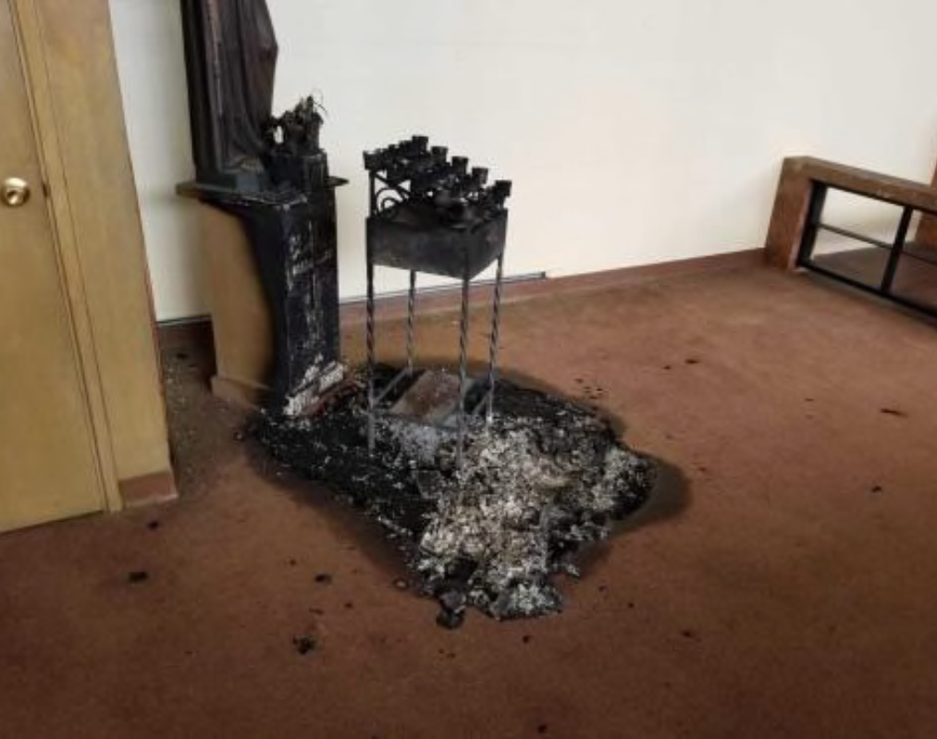
FIRE EVENT

Slide 7
SERIES OF EVENTS
Fire self extinguishes sometime overnight
12 hours later, Church reopen & staff notices fire
Industrial hygienist is dispatched with clean up contractor. Original plan was smoke/soot clean up.

Slide 8
CONSEQUENCES
Initial reserve estimate for cleaning <$100,000
Smoke/Soot entered HVAC System – System Cleaned
Smoke/Soot damaged carpeting – Entire Church carpet replaced

Slide 9
CONSEQUENCES
Walls cannot be cleaned – Substantial interior repainting
Claim grows to $300,000
CCAS self insured to $250,000. Excess covered by carrier

Slide 10
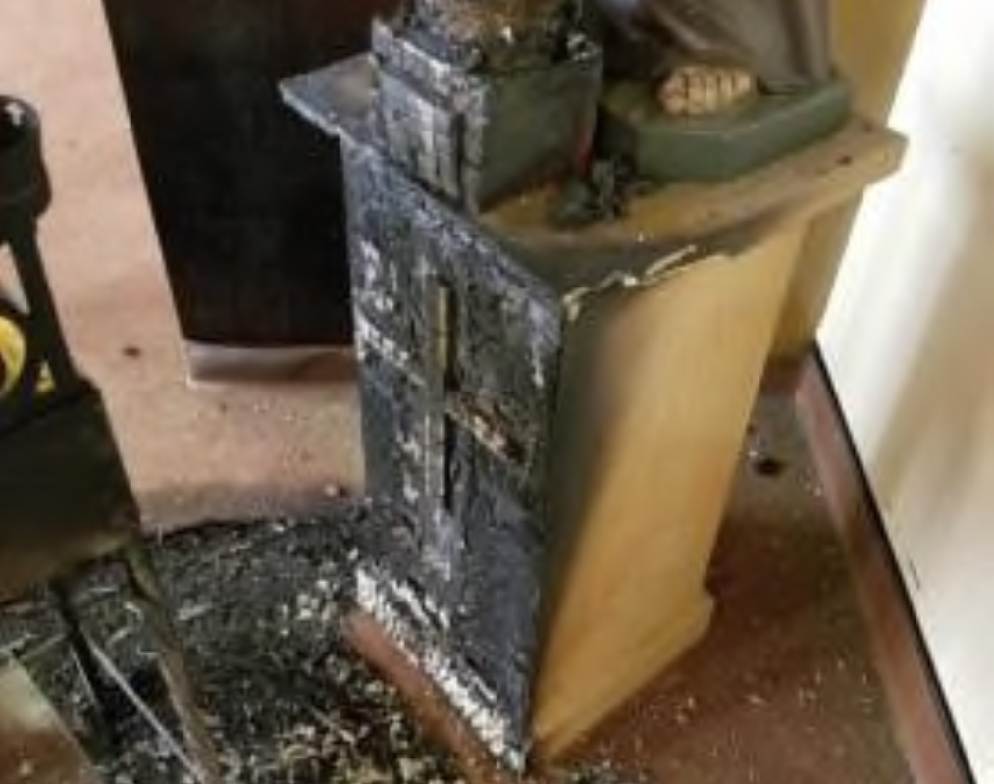
COMBUSTABLE STATUE BASE

Slide 11
FAILED VOTIVE CANDLE HOLDER

Slide 12
COMUBUSTABLE CARPET BELOW HOLDER

Slide 13
REMEDIES
1. If votive candle stands are used, noncombustible material such as tile, stone, marble, or granite should be in place beneath the candle lighting/burning area. If candle stands are positioned over carpet, provide a fire resistant mat or Plexiglas sheet under the stands to reduce fire as well as protect the surface underneath from damage due to dropped matches or spilled candle wax.

Slide 14
REMEDIES
2. Do not allow candles to be brought into church from parishioners or visitors. Only allow parish candles purchased by a reputable candle manufacturer to be displayed and lit. Many of the candles purchased at discount stores are improperly made and have been the source of numerous fires.

Slide 15
REMEDIES
3. Keep candles away from combustible items such as linens, runners, or curtains. Even flowers placed too close to a flame can ignite when they become dry.
4. Keep candles and all open flames away from flammable liquids.

Slide 16
REMEDIES
5. Candles should be placed in double-insulated containers or secured by a sturdy non-combustible base/holder.
6. Care must be taken in the placement of candles in relation to seating, foot traffic areas, and exits.

Slide 17
REMEDIES
7. Keep candles free of foreign objects such as matches and wick clippings.
8. Ensure matches, lighting sticks and lighters are safely out of the reach of children.

Slide 18
REMEDIES
9. Provide a noncombustible container filled with sand to extinguish and place matches or lighting sticks.

Slide 19
REMEDIES
10. Discourage the use of candles in schools and all offices. The only exception should be for religious/prayer purposes in a classroom, but the candle must be extinguished immediately when concluded.

Slide 20
REMEDIES
11. Keep wicks trimmed to one-quarter inch and extinguish them when they get to within two inches of the holder. Candles should be extinguished before the last half-inch of wax begins to melt.

Slide 21
REMEDIES
12. Extinguish candles with a snuffer, avoiding burns from hot wax.
13. Let candles and holders cool sufficiently prior to moving.

Slide 22
REMEDIES
14. Never leave a candle burning in an unoccupied room. The only exceptions would be for votive candles or the sanctuary lamp candle. These candles are specifically manufactured to burn until they self-extinguish.

Slide 23
REMEDIES
15. Never let candles burn for more than four hours at a time. The same exceptions as above would apply.
16. The flame of a candle should not be closer than three inches to other candle flames.

Slide 24
REMEDIES
17. No lit candles on live or artificial holiday greenery. Exception: Any artificial wreath (i.e. advent wreath must be fire retardant treated and candles set in protective container).

Slide 25
REMEDIES
18. Ensure a 5 pound ABC dry chemical fire extinguisher is wall mounted near the location of candles.

